Slide 1
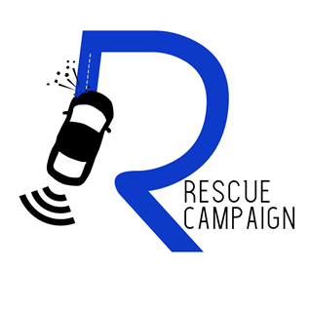
RECUE CAMPAIGN TRIBUTE ON WORLD DAY OF REMEMBRANCE FOR ROAD TRAFFIC VICTIMS
16 November 2019
NPC – 2019/113385/08 NPO – 228-276

Slide 2
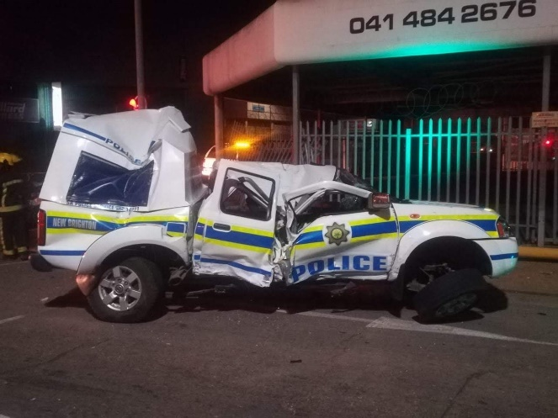
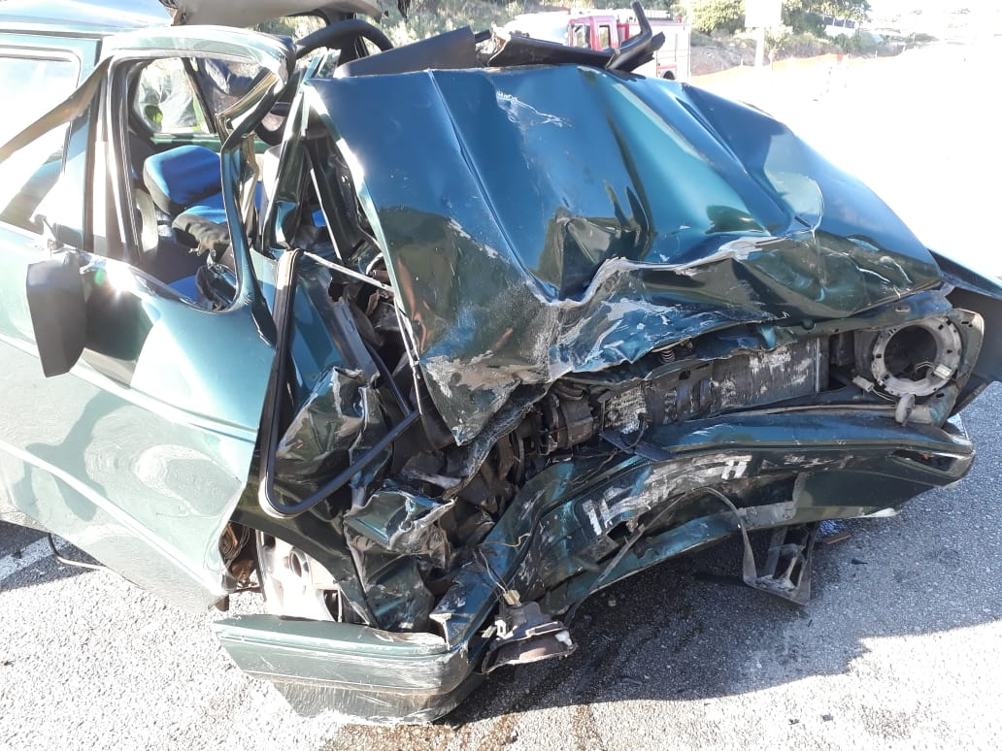
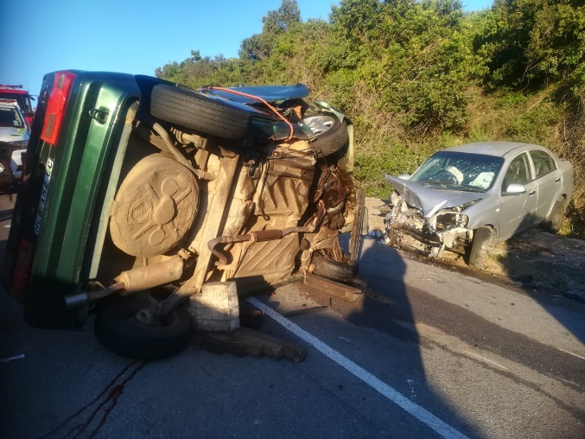
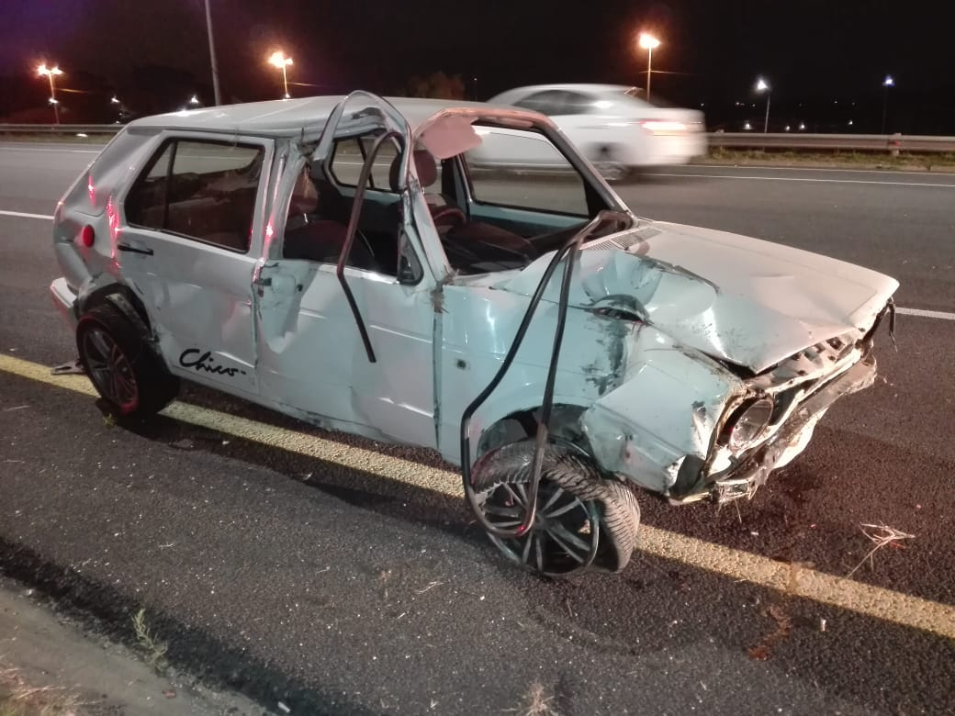
World Day of Remembrance
The World Day of Remembrance for Road Traffic Victims (WDR) is commemorated on the third Sunday of November each year – to remember the many millions killed and injured on the world’s roads, together with their families, friends and many others who are also affected. It is also a Day on which we thank the emergency services and reflect on the tremendous burden and cost of this daily continuing disaster to families, communities and countries, and on ways to halt it.

Slide 3
Why
In 2012 Annie Bezuidenhout's’ stepson was in a motor vehicle accident. He sustained major head and back injuries, a broken collar bone, and an almost broken neck. He was flung from the car as a result of the impact. His recovery was a physical, mental, and emotional journey; affecting not only him but the entire family. The experience gave the Bezuidenhout’s a front seat view to the importance of road safety, and the after-effects of surviving a major road accident. The ramifications were not only medical, but also, legal. As a mother, Annie couldn’t stop thinking about how much worse the outcome could have been.
The reality was that the accident was completely avoidable if the necessary road safety precautions were taken and the rules of road were adhered to. Being an already tightly-knit family , this incident brought us even closer. They came to realize the value of life and the need to enhance road user education and training for all. All road users need to know how to manage vehicles safely and deal with changing conditions on the road.
Established in 2019, the Rescue Campaign NPO exists to put preventative and supportive measures in place to reduce the devastating effects of motor vehicle accidents on individuals ,their families, the greater community, and the economy at large by way of road safety awareness, advanced training, and legal advice.
Like many others, know what it’s like to see a loved one hurt as a result of a road accident and we want to make our roads safer because of it.

Slide 4
Compassion
for our survivors and their families
It is important to acknowledge the impact of road crashes at household level. Motor vehicle accidents have a major effect on families, especially lower-to-middle income households. The impact that losing a loved one has on a family is enormous, both emotionally and financially. If the head of a household is killed or severely injured, the impact to that household can be devastating. Research shows that road crashes impact household income, levels of unemployment, divorce rates, as well as income gaps for road accident survivors. Further to this, depression, anger, anxiety, and a loss of motivation are more commonly reported in relatives of survivors left with disabilities than survivors themselves.
Consistency
in providing road safety education, assistance and expertise to all
The basic knowledge level of road users indicates that they understand the fundamentals of vehicles, driving and road usage rules. What is clearly lacking are the skills to manage vehicle safely and deal with changing conditions on the road in a safe manner. The actual skill level of the average road user needs to be upgraded and driver awareness and training is a primary tool in achieving this.
Commitment
to our cause
All too often we talk about the people who have died on our roads. For the survivors, studies show that 40% of them don’t improve with treatment up to six years after the collision. We sometimes overlook the impact these accidents have on families, relationships, communities and futures. This campaign gives us an opportunity to truly understand the real human impact of road collisions and how we can work together to prevent the tragedy and bloodshed taking place on our roads.

Slide 5
The Event Vision
The Rescue Campaign Tribute includes a 37-kilometre motor vehicle convoy from Kings Beach to St Albans Proposed road closures on the day as an estimated 250+ vehicles are expected to participate in the convoy. Participants include the general public as well as corporate entities, emergency services, and municipal constituencies.
A full-day programme will commence at the Rescue Campaign facilities inclusive of Emergency Services Simulations, Taxi overloading demonstration VIP keynote speakers,, testimonies by road crash survivors as well as advanced driving safety demonstrations including hi-jack prevention.

Slide 6
Proposed programme
07h30 to 08h00 Registration Open at Kings Beach parking lot.
08h00 to 09h00 Police, emergency vehicles, bikers and motorist drive in convoy from King Beach, down Marine Drive, towards N2 to SSS Advance Driving
09h30 to 10h15 Marching band will lead convoy into facility
10h30 to 11h00 Words of encouragement from Dignitaries
11h00 to 11h20 Speeches by Sponsors
11h20 to 11h30 Story of appreciation by victims of mva’s
11h40 to 13h00 Emergency Services Simulation
13h00 to 13h15 Taxi overloading demonstration
13h15 to 13h30 Performance .
13h30 to 14h00 Collision avoidance and Highjack demonstration
14h00 to 14h30 Performance
15h00 Thank you by RESCUE CAMPAIGN

Slide 7
STRATEGIC PARTNERS
South African Police Services
Emergency Services
Traffic Departments
Corporates supplying related products and services
Media
Members of the public

